Slide 1
Implementation of parameter-reduced LSTM variants
By: Vishal Asnani
APID: A59854621
Guided by: Prof. Fathi M. Salem

Slide 2
Objective
Modified parameter-reduced variants of LSTM layers are introduced into the model.
LSTM5a and LSTM6 variants of LSTM layer are included in the model and compared with eith the standard LSTM model.
Analysis of experimental results have been done for both models.

Slide 3
Introduction
Predictions done on the basis of time series data is one of the hardest problems in data science.
Long term-short term memory networks are well suited for predictions based on time series data.
LSTMs network can remember information for long periods of time.

Slide 4
LSTM Architecture
Each LSTM unit is comprised of a cell and three gates.
The cell is called the memory of the unit while the gates provide the flow of information inside the LSTM unit.
Three types of gates are used in the LSTM unit:
Input gate: Control the flow of input activations
Output gate: Control the output flow of cell activations
Forget gate: To adapt forgetting or resetting the cells memory.

Slide 5
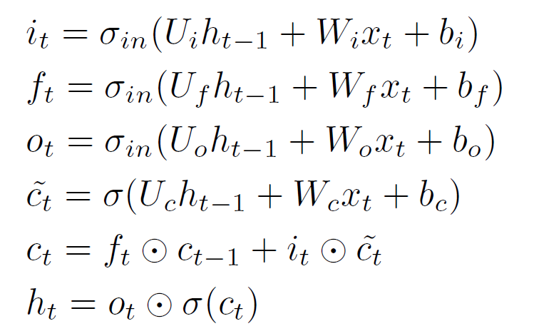
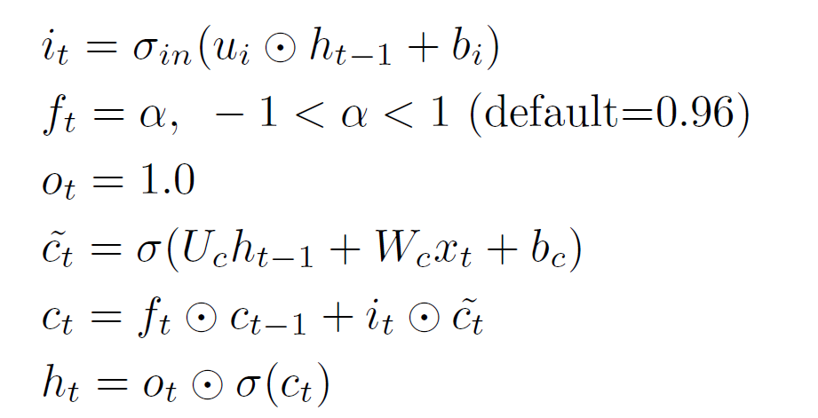
LSTM Equations
Standard LSTM : The basic LSTM uses memory cells in the base network while incorporating three gating mechanisms to access the sequence data.
First three equations represent the gating signals while other equations represent the memory-cell networks
2. LSTM 5a model:
To preserve BIBO stability, a real number in absolute value less than 1 is set for the forget gate.
The output gate is set to 1.

Slide 6
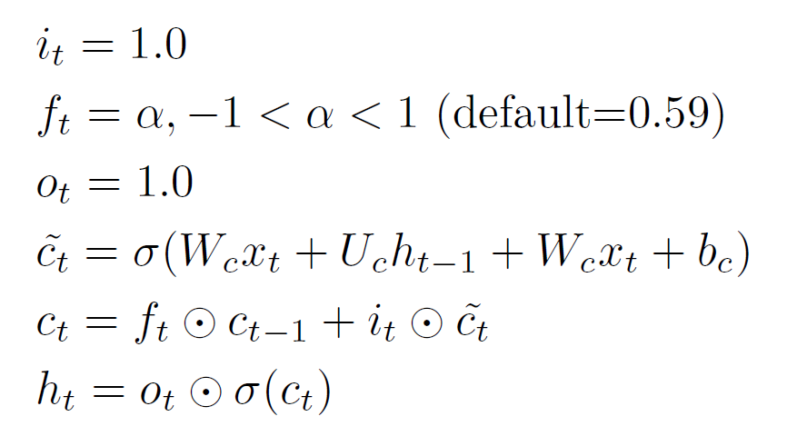
LSTM Equations Cont..
3. LSTM 6 model:
All gating equations are replaced by appropriate constant
Forget gate value is set below 0.59 for BIBO stability.
The other two gates are set to 1.

Slide 7
Dataset
UCI news aggregator dataset is used for training both models.
The dataset is divided into 4 different categories: Business; Science and Technology; entertainment; and health.
The dataset is reordered based on index and label value.
A hot encoding is used for an efficient implementation of the model.
Tokenizer API is used for creating unique tokens by eliminating any other character so as to set up the input data into merger

Slide 8
Model Description
The model was built using high level Keras API.
Embedding layer of dimension 128 is used to generate word embeddings to solve the issue of sparse vectors of high dimensionality.
Three convolution layers are added with filter size as 64, kernel size as 3 and ‘Relu’ activation followed by Max pooling layer.
LSTM5a and LSTM6 layers are then added to the model with 64 hidden units, 20% dropout and ‘tanh’ activation.
Finally, a dropout layer with dense layer is added to the model.
The model is used to run for 10 epochs with RMSprop optimizer and loss as binary cross entropy.
Exponential learning is also used to update learning rate after every epoch.

Slide 9
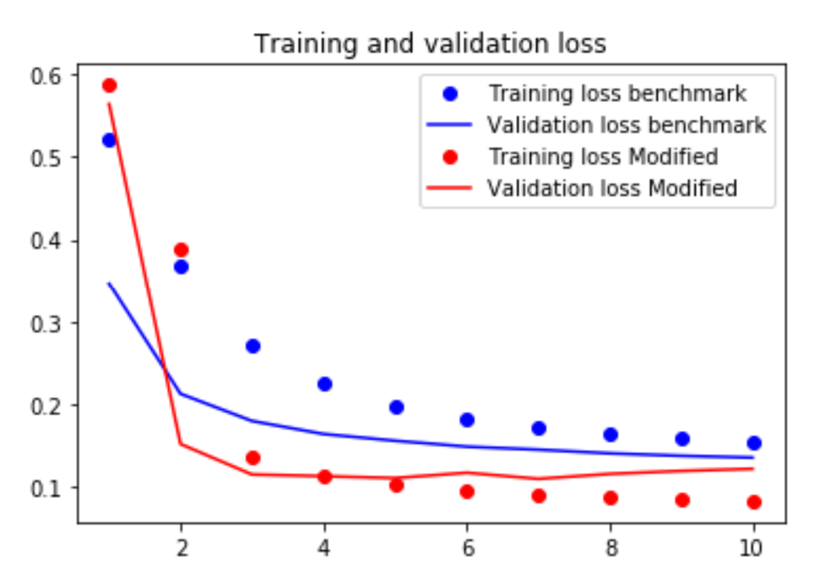
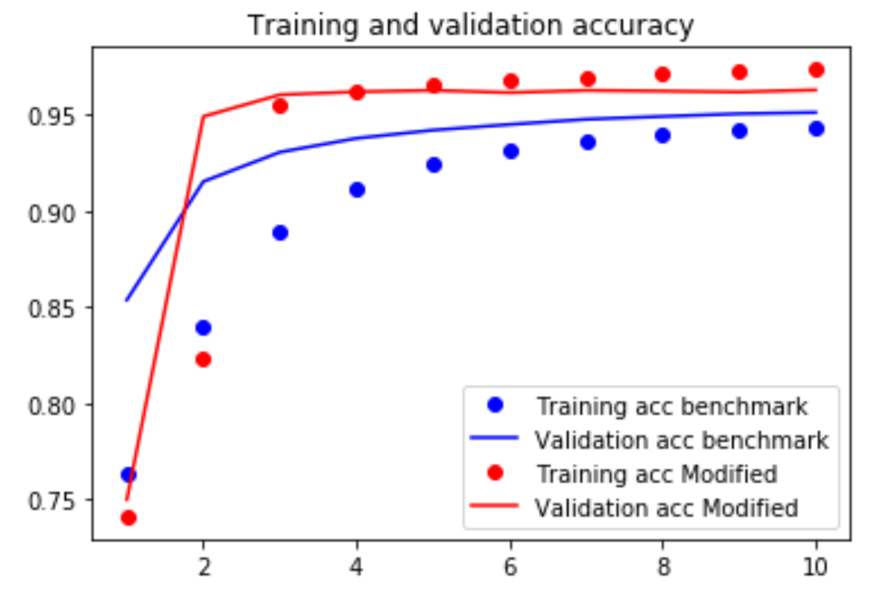
Experimental Results
Figure 1: Accuracy and loss of model with standard and modified LSTM

Slide 10
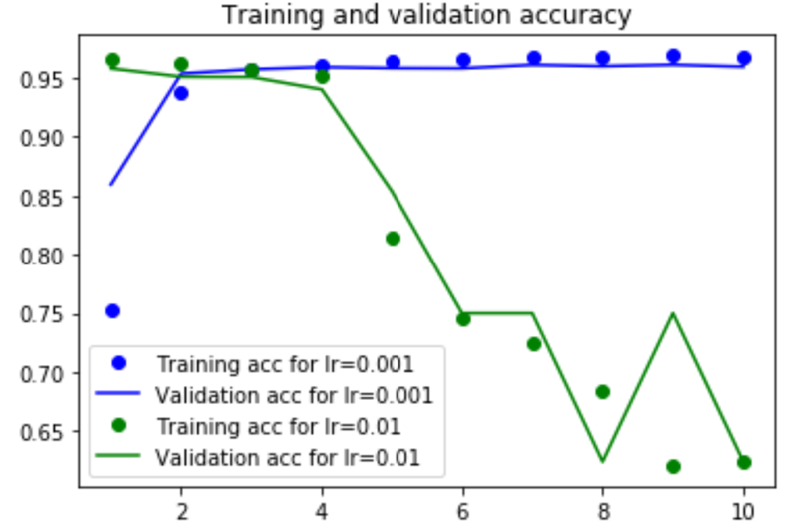
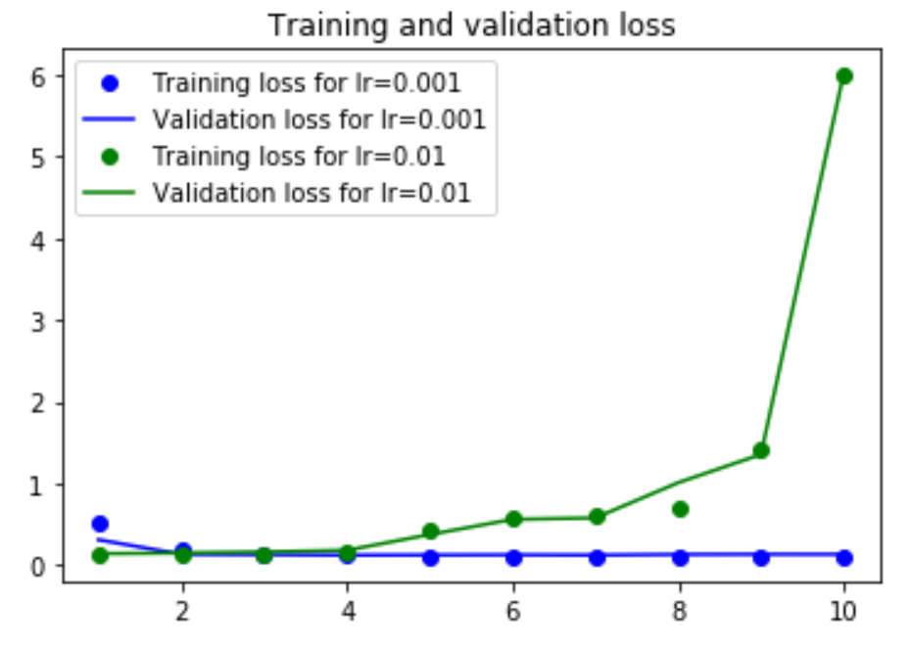
Experimental Results cont..
Figure 2: Accuracy and loss of model with different learning rates

Slide 11
Experimental results cont..
Model | Accuracy (%) | Loss
Standard LSTM | 95.1 | 0.14
Modified LSTMs | 96.1 | 0.132
Learning rate | Accuracy (%) | Loss
0.001 | 96 | 0.133
0.01 | 62.6 | 5.997

Slide 12
Conclusion
A model with two parameter-reduced variants of standard LSTMs and convolutional layers was compared with the model comprising of standard LSTM layer.
The two parameter-reduced LSTMs used were LSTM 5a and LSTM 6.
There has been a 1% increase in the accuracy of the modified model.

Slide 13
References
Hochreiter, S., Schmidhuber, J. Long short-term memory. Neural Computation, 9(8):1735–1780, 1997.
Chung, J., Gulcehre, C., Cho, K., and Bengio, Y. Empirical Evaluation of Gated Recurrent Neural Networks on Sequence Modeling. arXiv preprint arXiv:1412.3555, 2014.
Cho, K., van Merrienboer, B., Bahdanau, D., Bengio, Y. On the properties of neural machine translation: Encoder-decoder approaches. arXiv preprint arXiv:1409.1259, 2014.
Salem, F., “A Basic Recurrent Neural Network Model,” arXiv. Preprint arXiv: 1612.09022, Dec. 2016.
Akandeh, A., Salem, F. M., Simplified Long Short-term Memory Recurrent Neural Networks: part II, arXiv. Preprint arXiv:1707.04623v1

Slide 14
Thank You

